Slide 1


Slide 2

English for Professionals Exam
Presenter Name(s)
Date

Slide 3
Agenda
Who is Pearson?
A legacy of education and testing for professionals
About E^Pro™
Measuring English skills for global success

Slide 4
Who is Pearson?
E^Pro™ is the result of Pearson’s long legacy of education and testing for professional advancement

Slide 5

Notes:
Pearson is the world’s largest educational business….
$9.2 billion annual sales
World’s largest assessments and testing business
Operations in 70 countries
More than 36,000 employees

Slide 6




Pearson: Our global organization
Education – As the world’s leading education company, Pearson provides educational materials, technologies, assessments and related services to teachers and students worldwide. Imprints include Scott Foresman, Prentice Hall and Addison-Wesley
Professional – Pearson’s Professional business segment, including Pearson VUE and Pearson Credential Management, are industry leaders in professional testing, publishing and training.
Financial Times – The FT is one of the world’s leading business news and information organizations, recognized internationally for its authority, integrity and accuracy.
Penguin Random House – Penguin Random House is the world’s first truly global trade book publisher.

Slide 7

Pearson Education
From pre-school to CEO
Education
  Pre-K-12
  Higher education
  Safari Books Online
Professional reference
Custom solutions
Assessments and testing

Slide 8



























Some of our test sponsors

Slide 9
Other High Stakes Uses of Our Technology
Immigration in the Netherlands
Airline Pilots and Air Traffic Controllers Worldwide (co-developed with FAA)
Border Patrol Agents in the US
Test of spoken Chinese for the Chinese government
Speaking section of the NASSCOM Assessment of Competency for BPO in India
9
Notes:
9

Slide 10
Millions of reasons sponsors choose
Pearson VUE
10,000,000+ candidate records managed
10,000,000+ exams delivered
10,000+ exam forms published
#1 customer service
* 2011 statistics

Slide 11
Innovations in testing
One registration system that integrates scheduling of proctored and un-proctored exams • Patented, company-owned test centers, 100% dedicated to testing • Enhanced security through next - generation biometrics — palm vein recognition • Audio items assess candidates through spoken response • An online resource center offering education tools for lifelong career development • Score report verification through photo authentication website • Open Source system easily integrates partner tools and technology • Automated scoring of essays and audio items • Interactive, graphical reporting dashboard • Digital photo and signature capture at all test centers globally • More ways to reach test takers — whether on a bus, campus, ship or military installation •

Slide 12
About E^Pro™

Slide 13

English skills are required for global business
Improve the quality of communication
Improve productivity
Reduce complaints attributed to language problems
Improve alignment across teams, regions
Reduce screening time, enable faster decisions
Reduce the number of hiring “mistakes”

Slide 14
Should you be testing language?
Customer-Facing
Staff
Conversations with customers by phone
Face-to-face customer interactions
Functional areas like:
  Customer service
  Sales
  Retail operations
  Front desk or guest services
  Technical support
Offshore Shared
Services/Biz Process
Offshore teams, either internal or outsourced
Written and spoken communication across regions
Functional areas like:
  Legal services
  Finance/Accounting
  Technical services
  HR admin./benefits
  Transaction processing
  Design/Creative services
Professional
Staff
Work on global project teams
Functional work across multiple regions
Leadership roles, overseas assignments
Functional areas like:
  Management
  Marketing
  Product development
  Finance & Admin
  IT/Engineering
  Professional services/ Consulting
14
Notes:
14

Slide 15

What is E^Pro™, the
English for Professionals Exam?
An innovative new English proficiency test that provides a more precise and realistic assessment of the English speaking skills of non-native speakers

Slide 16
E^Pro™ value proposition
By offering institutions a more accurate and responsive testing solution for understanding the existing English communication skills and training needs of their constituents, E^Pro™ gives confidence and assurance to management that they are using the best resources available to them to prepare their organization to meet the challenges of global markets. E^Pro™ ensures that employees have the English skills to:
support a company’s global strategy
work effectively with colleagues, customers, partners and suppliers
align with global processes and best practices

Slide 17

Why E^Pro ™?
Integrated:
  E^Pro™ tests 4 pillars of English in one exam, including productive skills: speaking, listening, reading and writing
  Efficient:
  90 minute exam, on-demand computer- based test
Relevant:
Tests business-related productive English communication skills used in the workplace
  Reliable:
  Delivered in highly secure Pearson VUE test centers; automated scoring

Slide 18
Why E^Pro™?
Accurate & Consistent
  E^Pro™ has proven quality and accuracy, delivering consistent, reliable testing without the typical variability of multiple evaluators and locations.
Cost-Effective
  With easy test administration and automated scoring, E^Pro™ provides a faster way to get results—and one that is more cost-efficient than other methods.
Scalable & Practical
  E^Pro can be taken on demand, in multiple external locations or in your own corporate office, making it the only practical solution for enterprise use.
18
Notes:
18

Slide 19
Competitive Advantage
From a world leader in learning and testing: Pearson is an internationally recognized leader in the field of English learning and in testing professional skills
Leading edge insights: four integrated skills better indicator of abilities
Real-world application: reflects actual communication requirements for middle management positions and higher
Convenience: less time away from work
Confidence: secure delivery and auto-scoring protects integrity of and trust in results
Ease of use: Full service and support reduces the workload for HR professionals
Flexible: On-demand testing
Faster, unbiased results: Automatically scored in 3-5 days
Advanced services for HR professionals: Benchmarking/standard setting for various jobs
Notes:
Four skills mirrors real world situations, productive skills as well as receptive
Reduces cheating and eliminates human and cultural bias

Slide 20
How is E^Pro™ used?
Recruiting, Hiring | Reliable, scalable screening of potential hires Verify communication skills for job performance Certify English for special requirements
Special Assignments & Projects | Verify English for global project teams or overseas assignments Assess readiness for leadership programs or promotions
Benchmarking Language Skills | Verify English levels of current employees Set corporate standard for spoken English
Language Training | Ensure accurate placement for targeted training Monitor progress of language skills acquisition Verify skills are acceptable with exit testing
20
Notes:
20

Slide 21
Test structure and design
Test takes about 90 minutes to complete
Speaking, listening, reading and writing questions
15 different integrated tasks
Measures productive as well as receptive skills
Test content is based on use of English in a workplace context
Taken on a computer in a proctored test center
Automatically scored by Pearson’s patented and proprietary technology (including speaking and writing)
Notes:
21

Slide 22
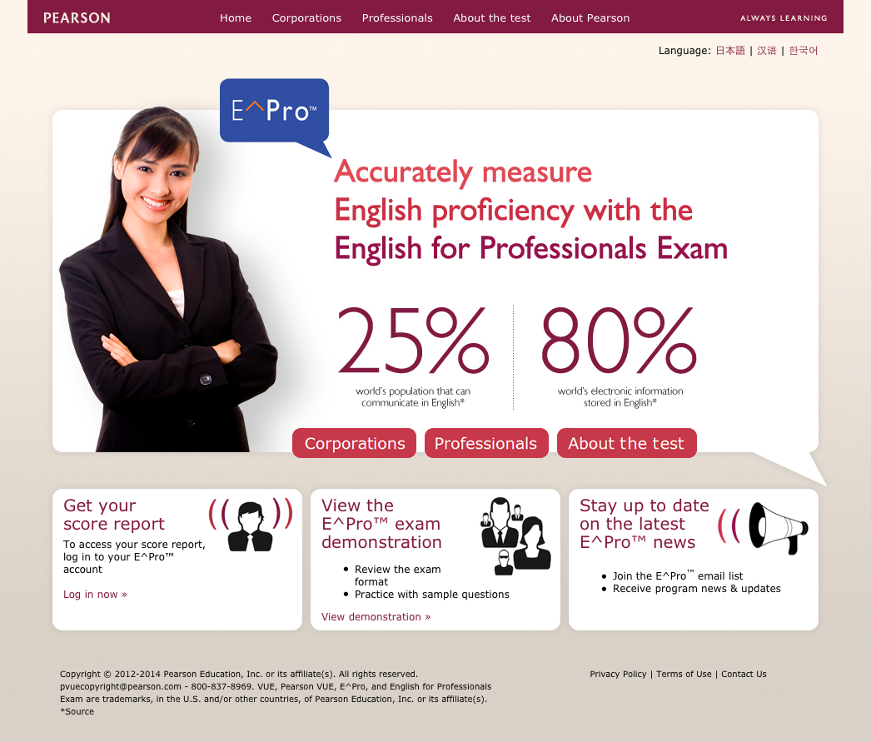
Website
Fully-functional website: www.eproexam.com
Targeted content for corporations & professionals
Detailed information on the test & score report
Exam registration process begins through the site
Notes:
22

Slide 23
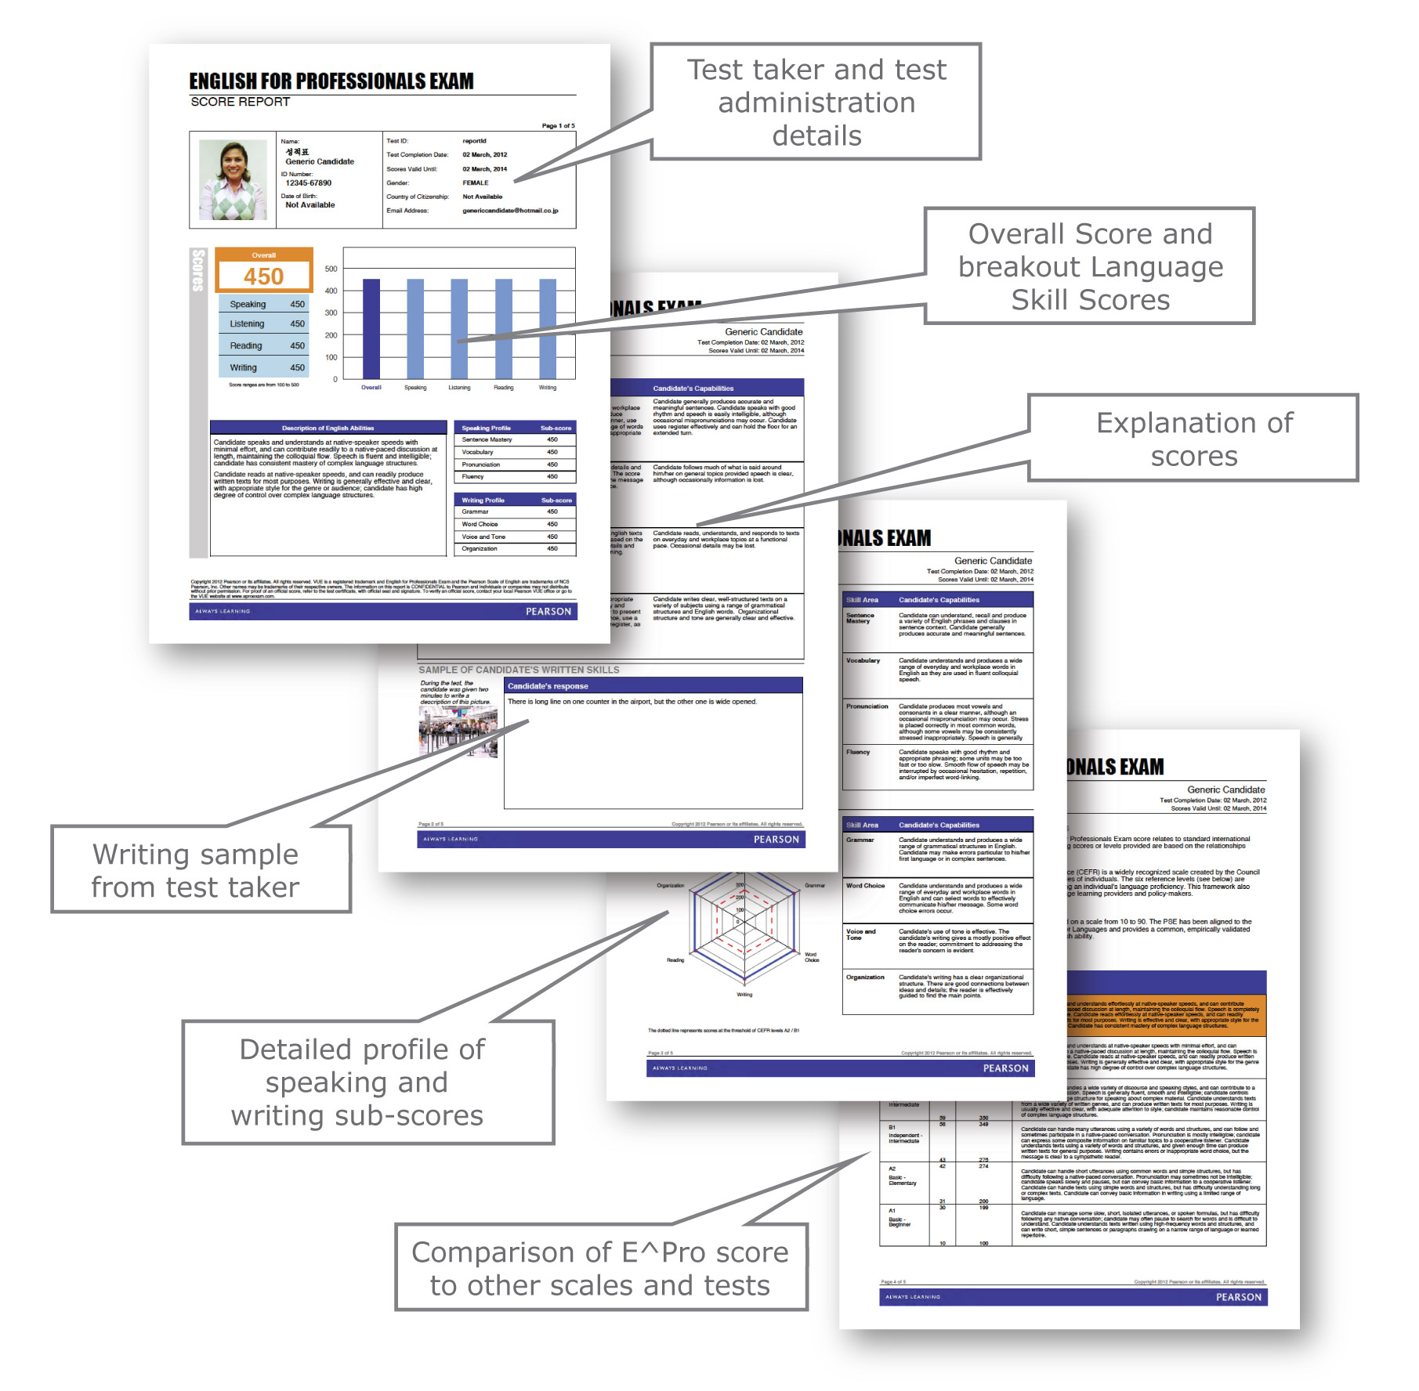
Candidate score report
Scores available within 3-5 days
Candidate receives comprehensive score report
Overall score, plus 4 skill scores and 8 sub-skill scores for key language areas
Maps to CEFR
Notes:
23
CD - I haven’t seen the pdf for scores from PKT, but they may include the development suggestions and score mapping. Should confirm.

Slide 24
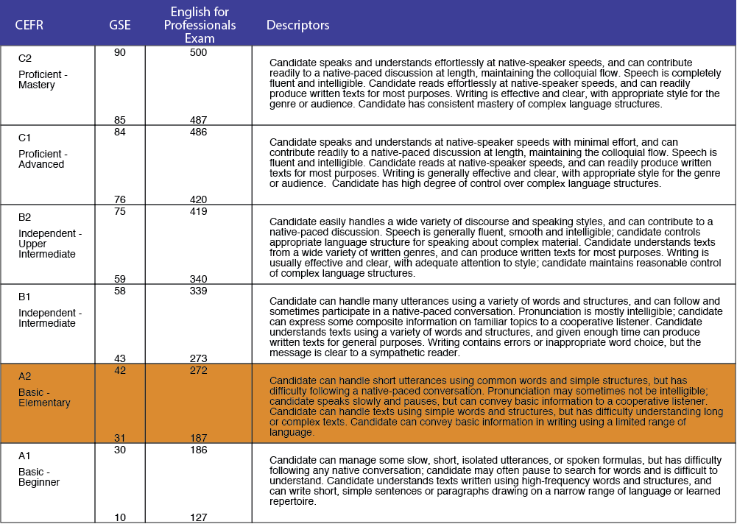
E^Pro Scores compared to CEFR and GSE

Slide 25

Eligibility & scheduling
Eligibility processing
  Automated process, real-time option
  Advanced error logging
  Systematic policy enforcement
Scheduling
  Customized Web registration
  Real-time scheduling
  Automatic authorization and confirmation
  Call center
Notes:
Automated import process, real-time option
Advanced error logging
Systematic policy enforcement
Scheduling/call center service
Web registration customized
All appointments scheduled in real-time
Automatic authorization to test and candidate appointment confirmation letters
Call center
Toll-free vanity number
International call centers
Call center open 7am – 7pm

Slide 26
Secure test delivery
E^Pro™ tests are delivered in secure, proctored test centers or may be delivered in your company-operated facility
  24/7 online scheduling
  Easy-to-use testing software
  Digital photo and signature printed on score report
  On-demand testing
  Secure data transmission to protect candidate and test data
Notes:
26

Slide 27
Thank you!

